Slide 1
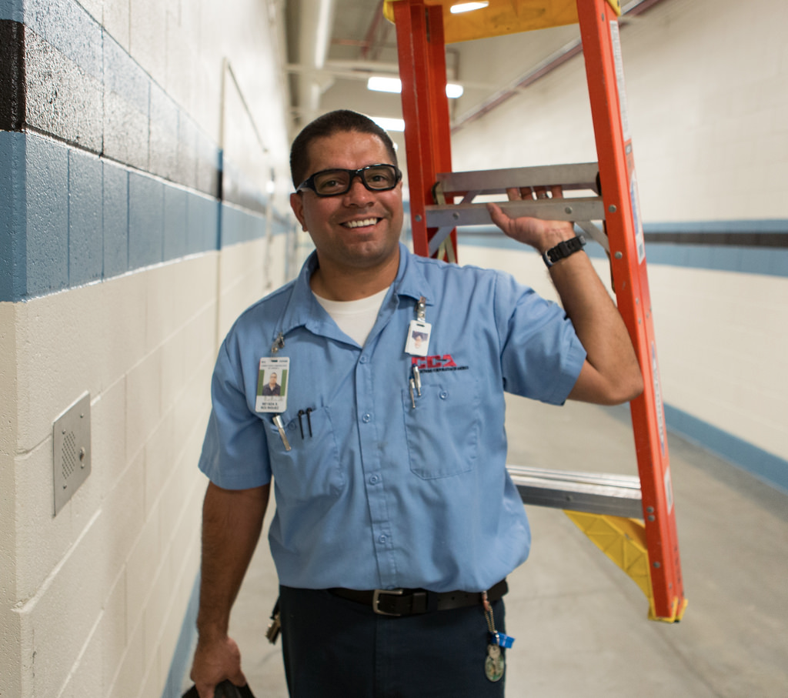
Keeping Maintenance Workers Aware
User and Problems:
Maintenance workers need to be aware of physical environment at all times to keep themselves and general population safe
Surrounding people often disregard safety barriers
Audio-Centric Solution:
improve physical hazard detection in new areas of low visibility, crawl spaces, and high student traffic
Example: detect live wires, exposed pipe, air quality, students encroaching into work area
Project Focus:
Evaluation

